Slide 1
INTRODUCTION TO LAB PROCEDURES AND TOOL USE
Chapter 2

Slide 2

Objective
2.1 Safe Lab procedures
Explain the purpose of safe working conditions and safe lab procedures.
2.2 Proper Use of Tools
Explain how to use tools and software with personal computer components.

Slide 3

2.1 Safe Lab Procedures
Procedures to People, Equipment and Data, and Environment
2.1.1 Procedures to Protect People

Slide 4
General Safety
• Make sure a first-aid kit is available.
• Unsecured cables create tripping hazards.
• Food and drinks should not be in the workspace.
• Remove jewelry.
Electrical Safety
Computer power supplies are dangerous when disassembled.
Watch for printer areas that are hot or that use high voltage.
Check the voltage output of AC adapters and chargers before connecting them to devices

Slide 5
Fire Safety
• Turn off the power and unplug equipment before performing service.
• Different types of fires require different types of fire extinguishers; make sure to use to correct one.
• Be alert for odors emitting from computers and electronic devices.

Slide 6

2.1.2 Procedures to Protect Equipment and Data
Environmental temperature and humidity levels also affect computers.
ESD (Electrostatic Discharge) and EMI (Electromagnetic Interference)
ESD can cause damage to computer equipment if not discharged properly.
ESD can build up on you as you walk on a carpeted floor.

Slide 7
EMI distorts the signals, degrading computer communication.
EMI can be generated by large motors, power lines, electrical storms, or any other source of electromagnetic energy.
Wireless networks are affected by RFI.
RFI is caused by radio transmitters transmitting in the same frequency.

Slide 8
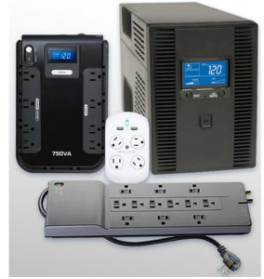
Power Fluctuation Types
Power fluctuations may impact the operation of computer components.
Blackouts, brownouts, noise, spike and power surge are types of power fluctuations that can cause data loss or hardware failure
Power Protection Devices
Surge suppressors, UPSs, SPSs are devices designed to protect computer systems from power fluctuations.
Laser printers should not be plugged to UPSs
Notes:
Fluctuation = an irregular rising and falling in number or amount; a variation

Slide 9
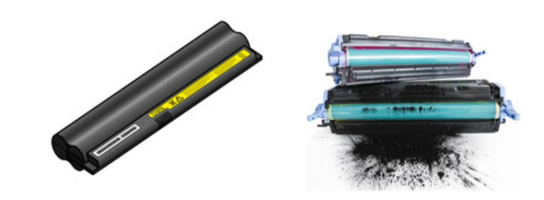
2.1.3 Procedures to Protect the Environment
Safety Data Sheet (SDS)
• Use an SDS to obtain information about a material, including procedures for proper disposal.
• The SDS contains information on the material’s composition, how it can affect personal health, fire hazards, and first-aid requirements.
• It also includes protective measures for the safe handling and storage of materials and spill, leak, and disposal procedures.

Slide 10
Equipment Disposal
Computer equipment contains hazardous materials and should be properly disposed.
Follow regulations to protect the environment and avoid fines.
Batteries, monitors, toner kits, cartridges, developers, chemical solvents and aerosol cans are examples of equipment that must be properly disposed.

Slide 11
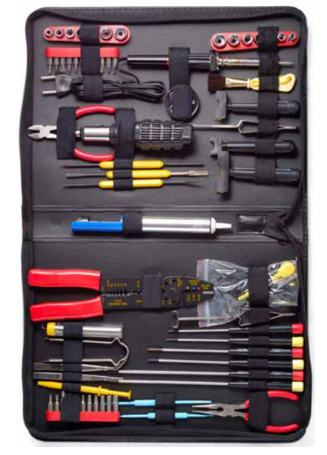
2.2 Proper Use of Tools
2.2.1 Hardware Tools
Hardware tools are grouped into:
ESD Tools
Antistatic wrist strap and antistatic mat
Hand Tools
Include screwdrivers, flashlights and pliers.
Cable Tools
Include wire cutters and strippers, crimpers and punch down tool.

Slide 12
Cleaning Tools
Include special cloths, chemicals and cable ties.
Diagnostic Tools
Include digital multimeters, loopback adapters, WiFi analyzer, external HDD enclosure

Slide 13
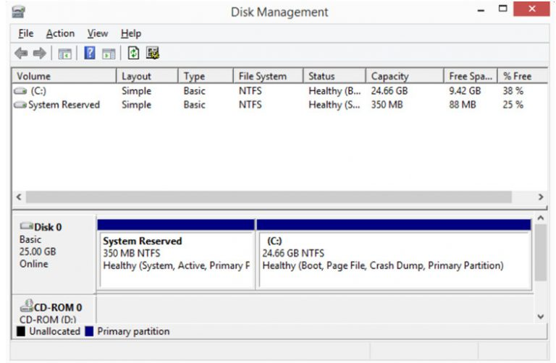
2.2.2 Software Tools
Like hardware tools, software tools are task-specific.
Used to diagnose problems, maintain hardware, and protect the data stored on a computer.
Disk Management Tools
Used for disk management, formatting, error checking, drive optimization, disk cleanup and more

Slide 14
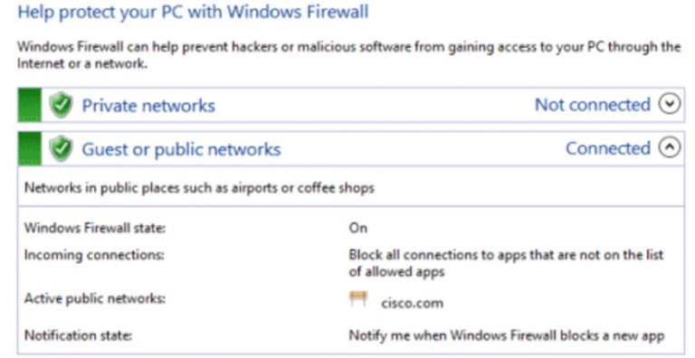
Protection Software Tools
Malicious software can damage or compromise operating systems, applications, and data.
Software protection tools include antivirus, antispyware, firewalls and update manager software.

Slide 15
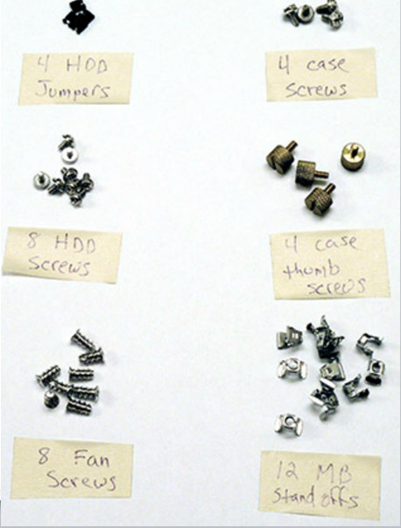
2.2.3 Organizational Tools
It is important that a technician document all services and repairs for future reference.

Slide 16
Personal Reference Tools
Include troubleshooting guides, manufacturer manuals, quick reference guides, and repair journals.
History of repairs and a notepad can be extremely useful as a technician performs troubleshooting and repairs.
The Internet can be a great reference tool by providing access to specialized forums, search engines, manufacturer’s FAQs, and more.
Miscellaneous Tools
Additional secondary items can be added to the toolkit.
Masking tape, a working computer and even pencil eraser can be very useful additions to a technician’s kit.

